Slide 1
Automatic Indexing

Slide 2
Classes of Automatic Indexing
Automatic indexing is the process of analyzing an item to extract the information to be permanently kept in index.
This process is closely linked to creating searchable data structures that represent the item.

Slide 3
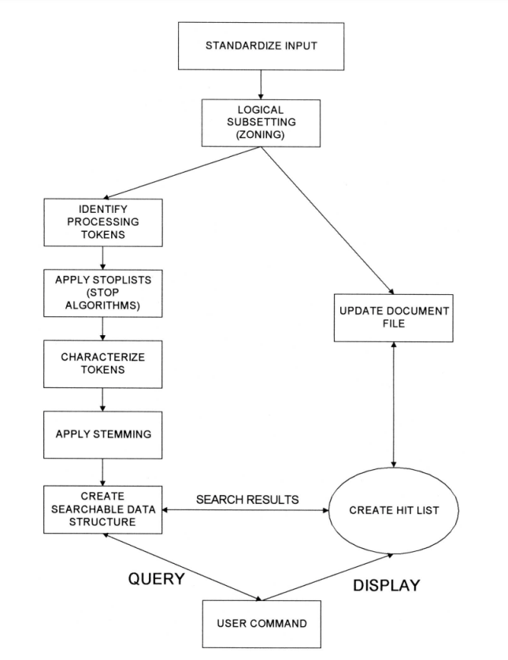
Classes of Automatic Indexing
The left side of the figure including Identify Processing Tokens, Apply Stop Lists, Characterize tokens, Apply Stemming and Create Searchable Data Structure is all part of the indexing process

Slide 4
Classes of Automatic Indexing
The indexing process begins with zoning the document, which divides it into manageable sections.
This is followed by identifying processing tokens—key elements that will be indexed.
To refine these tokens, filters like stop lists (which eliminate common, uninformative words) and stemming algorithms (which reduce words to their base forms) are applied.

Slide 5
Classes of Automatic Indexing
After token refinement, the system’s search strategy determines how to utilize the index.
Search strategies fall into three main categories:
statistical,
natural language, and
concept-based.
Ultimately, the index itself is a data structure designed to support these strategies, enabling efficient retrieval of information based on user queries.

Slide 6
Classes of Automatic Indexing
Statistical strategy - covers the broadest range of indexing techniques and common in commercial systems .
These strategies are based on the frequency of occurrence of events, particularly the processing tokens (words or phrases) found in documents and databases.
These tokens serve as the domain of searchable values.

Slide 7
Classes of Automatic Indexing
Various statistical methods are applied to this event data, including probabilistic, Bayesian, vector space, and neural network approaches:
Static Approach: This method records basic statistics, such as the frequency of each word in an item, which helps generate relevance scores following a standard Boolean search.
Probabilistic Indexing: This technique calculates the probability that a specific item is relevant to a given query by storing relevant statistical information.
Bayesian and vector space – The Bayesian and Vector Space approaches both gather and analyze information to evaluate how confident we can be about an item's relevance to a query.
Neural Networks: These are dynamic learning structures that fall under concept indexing. They help identify concept classes and are particularly useful for understanding the relationships between terms and concepts in data.

Slide 8
Classes of Automatic Indexing
Natural Language approaches begin similarly to statistical techniques by identifying processing tokens, but they go further by incorporating natural language parsing.
This parsing helps clarify the context of these tokens, allowing the system to understand nuances such as verb tenses (e.g., present, past, future) and to generalize to broader concepts.
Concept indexing uses the words within an item to correlate to concepts discussed in the index item.
When generating concept classes automatically, it’s possible that the resulting concepts do not have specific names associated with them; instead, they are defined solely by their statistical significance.
This means that the system identifies and groups related terms based on their occurrence patterns and relationships within the data, rather than assigning traditional labels.

Slide 9
Classes of Automatic Indexing
Finally, a special class of indexing can be defined by creation of hypertext linkages.
These linkages provide virtual threads (connection) of concepts between items versus directly defining the concept within an item.
Each indexing technique has its strengths and weaknesses.
Current evaluations from TREC conferences indicate that to achieve the best results in locating relevant items, it is beneficial to apply multiple algorithms to the same dataset.
However, this multi-algorithm approach comes with significant storage and processing overhead, making it essential to balance effectiveness with resource efficiency.

